Slide 1

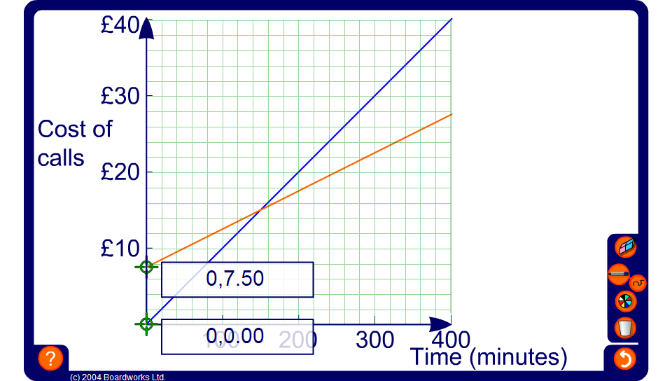


Graph of monthly mobile phone charges
Notes:
Explain that graphs can be used to illustrate any function or formula containing two variables.
This graph compares two types of tariff offered by a mobile phone company:
The ‘Pay as you go’ tariff (shown in blue) has no monthly charge and charges a fixed amount per minute. Drag the moving point on the graph to help pupils work out the cost per minute. This is £0.10 p per minute.
The ‘Monthly’ tariff (shown in red) has a fixed monthly charge and charges calls at fixed amount per minute. Drag the moving point on the graph to help pupils work out the monthly charge and the cost per minute. This is £7.50 for the monthly charge and £0.05 per minute for calls.
Ask pupils for the significance of the point where the two lines cross. This is the point where the two tariffs cost the same amount for the same amount of time spent on calls.
Ask pupils which tariff is cheaper. Establish that if we spend less than 150 minutes (2½ hours) on calls in a given month then the ‘Pay as you go tariff’ is cheaper. If we spend more than 150 minutes on calls in the month then the monthly tariff is cheaper. (150 minutes a month is about 5 minutes a day.) If we include another month we would have to pay another £7.50 on the ‘Monthly’ tariff.
Discuss whether or not the intermediate points have any practical significance.
Suppose we could zoom in on the graph to read off the charge in pence and the time in seconds. Since calls are rounded to the nearest penny and the time spent on the phone is rounded to the nearest second, intermediate points between pennies and seconds, although they have a practical significance in theory, would have to be rounded up.
Ask pupils to suggest a formula to describe each tariff. For example, for the ‘Pay as you go’ tariff:
Cost in pence = 10 × number of minutes (or C = 10n)
and for the ‘Monthly’ tariff:
Cost in pence = 5 × number of minutes + 7.5 (or C = 5n + 7.5).

